Slide 1
Load Balancing Algorithms in Cloud Computing
Piyush Bajaj
Saketh Saxena
CS 218 Project 1: Research Project

Slide 2

Agenda
Introduction
Existing cloud load balancing algorithms
Load Balancing based on Bayes and Clustering Algorithm
Load Balancing Algorithm for Virtual Cluster Using Fuzzy Clustering
Conclusion
Future Work
References

Slide 3
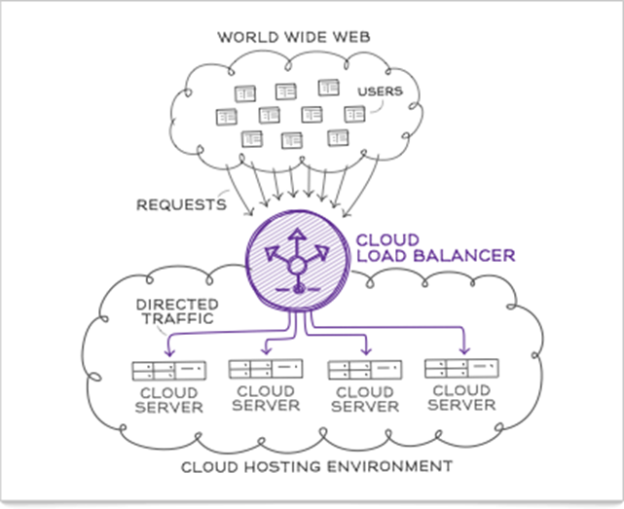
Introduction
What is cloud load balancing?
process of distributing dynamic workload across multiple computing resources.[2]
Fig 1: schematic representation of load balancing in cloud [6]
Notes:
Advantages such as high availability and scalability
Cloud Load Balancing is a process of distributing dynamic workload across multiple resources and equalize it across all nodes to achieve efficiency and increases throughput [4].
Doubt : Workload – number of tasks, CPU utilization.

Slide 4
Why is Load Balancing required?
Optimize resource utilization
Ensure high availability
Scale up efficiently
Maximize throughput
Reduce power consumption
High user gratification
Notes:
It helps in avoiding deadlocks by optimal utilization of resources and increases the system performance.
Throughput – max rate at which tasks can be processed.
HA – no single node is overwhelmed and can handle requests in time
Power consumption – Highly loaded servers require more power and idle servers still consume 70% of peak power.

Slide 5
Classification of Load balancing algorithms
Two types of load balancing algorithms
Static - traffic divided evenly among all servers, requires prior knowledge of system resources.[6]
ex: OLB, LB Min-Min, round-robin, weighted round-robin, LB Min Max.
Dynamic – lightest server in the network is selected for load balancing; current state of the system is used to make decisions for load balancing.[7]
ex: Join-Idle-Queue, Honey bee foraging, Active clustering , Ant colony optimization, Biased random sampling.
Notes:
Static algorithms are appropriate for systems with low variations in load [11]. In static algorithm the traffic is divided evenly among the servers. This algorithm requires a prior knowledge of system resources the performance of the processors is determined at the beginning of the execution, therefore the decision of shifting of the load does not depend on the current state of system [12]. However, static load balancing algorithms have a drawback in that the tasks are assigned to the processor or machines only after it is created and that tasks cannot be shifted during its execution to any other machine for load balancing [13]
In dynamic algorithm the lightest server in the whole network or system is searched and preferred for balancing a load. For this real time communication with network is needed which can increase the traffic in the system. Here, current state of the system is used to make decisions to manage the load [11]. Dynamic algorithms respond to the actual current system state in making load transfer decisions. Since current state of the system is used to make dynamic load balancing decisions, processes are allowed to move from an over utilized machine to an under utilized machine in real time dynamically [13].

Slide 6
Existing Load Balancing Algorithms
Load Balancing Algorithms
Static
Opportunistic Load Balancing
Load Balancing Min-Min
Dynamic
Job-Idle-Queue
Honeybee Foraging Behaviour

Slide 7
Opportunistic Load Balancing
Assigns workload to nodes in free order without considering the expected execution time of each node.
Attempts to keep each node busy
Advantage - Simple to implement.
Overall completion time is very poor.
Results in bottlenecks.
Variations of this technique such as round-robin load balancing.
[3] Kansal, Nidhi Jain, and Inderveer Chana. "Cloud load balancing techniques: A step towards green computing." IJCSI International Journal of Computer Science Issues 9.1 (2012): 238-246.
[6] Shah, Nadeem, and Mohammed Farik. "Static Load Balancing Algorithms In Cloud Computing: Challenges & Solutions." International Journal Of Scientific & Technology Research 4.10 (2015).
Notes:
round robin selects first node randomly hence variation of olb

Slide 8
Load Balancing Min-Min
Simple task scheduling algorithm which considers the execution time and completion time of the tasks and machines. The LBMM works as follows:
1. Starts with a set of unmapped tasks:
2. Machine with the minimum completion time for all jobs is selected
3. The job with the overall minimum completion time is selected and mapped to resource
4. Steps 1-3 Repeated till all unmapped tasks are assigned.
Works best when number of small tasks is greater than number of large tasks.
LBMM leads to starvation
[5] Zhao, Jia, et al. "A heuristic clustering-based task deployment approach for load balancing using bayes theorem in cloud environment." IEEE Transactions on Parallel and Distributed Systems 27.2 (2016): 305-316.
[6] Shah, Nadeem, and Mohammed Farik. "Static Load Balancing Algorithms In Cloud Computing: Challenges & Solutions." International Journal Of Scientific & Technology Research 4.10 (2015).
[8] Kokilavani, T., and DI George Amalarethinam. "Load balanced min-min algorithm for static meta-task scheduling in grid computing." International Journal of Computer Applications 20.2 (2011): 43-49.
Notes:
The completion time is calculated by adding the expected execution time of a job on that resource with the resource’s ready time.

Slide 9
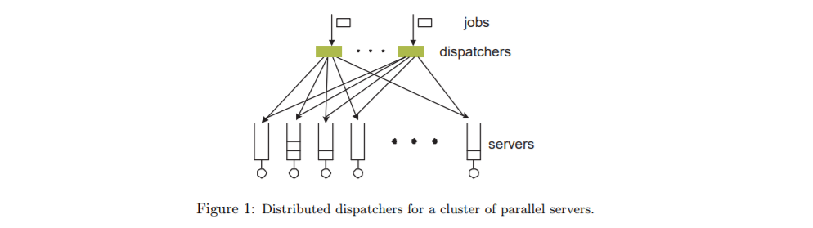
Join-Idle-Queue
Provides large scale load balancing with distributed dispatchers.
Decouples discovery of lightly loaded servers from job assignment thus reducing system load.
When a server is idle, it informs despatcher.
Useful for dynamically scalable web services.
Does not increase actual response time.
Figure 2: Distributed dispatchers for a cluster of parallel servers[4]
[3] Kansal, Nidhi Jain, and Inderveer Chana. "Cloud load balancing techniques: A step towards green computing." IJCSI International Journal of Computer Science Issues 9.1 (2012): 238-246.
[4] Lu, Yi, et al. "Join-Idle-Queue: A novel load balancing algorithm for dynamically scalable web services." Performance Evaluation 68.11 (2011): 1056-1071.
Notes:
By removing the load balancing work from the critical path of request processing, it effectively reduces the system load.
Use I-queues data structure at dispatcher which stores the state of processors

Slide 10
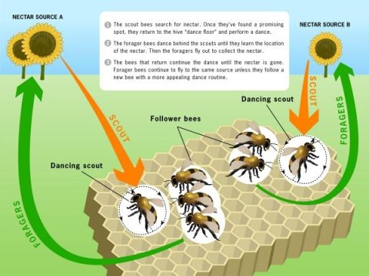
Honeybee Foraging Behaviour
Decentralized honeybee behavior - based load balancing technique for self-organization inspired by the nature[9].
scouts and foragers – “waggle dance”
Uses local server actions for global load balancing – process queues.
Performance of system enhanced due to increased system diversity.
Throughput of the system is affected due to increased system size – profit computation.
It is best suited for the conditions where diverse population of service types is required.
Figure 3: Honeybee foraging behaviour
Credit: Image courtesy of Georgia Institute of Technology
[1] Bhavya, V. V., K. P. Rejina, and A. S. Mahesh. "An Intensification of Honey Bee Foraging Load Balancing Algorithm in Cloud Computing.“
Notes:
Honey bee foraging algorithm works similarly the way in which bees find and gather their food. There are two categories of bees namely, forager bees and scout bees. Food is searched by the Forager bees and they announce it to other bees when they get it. They announce it by doing waggle dance which shows the availability of metadata food. Then the scout bees follows the forager bees and collect honey from the source. After returning, they does a waggle dance to indicate the food left so that more honey can be consumed. In load balancing International Journal of Pure and Applied Mathematics Special Issue 130 services are assigned dynamically as the users’ demands changes. Here, the servers are made into a group of virtual server and each virtual server maintain a process queue. The profit is calculated after processing the request. High profit makes the server stay, and low profit levels trigger a return to foraging. Each node maintains a separate queue. Profit computation cause additional overhead, which results in deterioration of throughput.

Slide 11
Newly proposed Load Balancing Techniques
Load Balancing based on Bayes and Clustering Algorithm (LB-BC) [5]
Load Balancing Algorithm for Virtual Clusters Using Fuzzy Clustering (LB-VC-FC)[2]
[5] Zhao, Jia, et al. "A heuristic clustering-based task deployment approach for load balancing using bayes theorem in cloud environment." IEEE Transactions on Parallel and Distributed Systems 27.2 (2016): 305-316.
[2] Huang, Weihua, et al. "Load balancing algorithm for virtual cluster using fuzzy clustering.“ Computer and Communications (ICCC), 2016 2nd IEEE International Conference on. IEEE, 2016. and Distributed Systems 27.2 (2016): 305-316.

Slide 12
Load Balancing based on Bayes and Clustering Algorithm(LB-BC)
[5] Zhao, Jia, et al. "A heuristic clustering-based task deployment approach for load balancing using bayes theorem in cloud environment." IEEE Transactions on Parallel and Distributed Systems 27.2 (2016): 305-316.

Slide 13
Load Balancing based on Bayes and Clustering Algorithm(LB-BC)
Most physical hosts in the cloud data center are so overloaded that it makes the whole cloud data center’ load imbalanced and that existing load balancing approaches have relatively high complexity[5].
Most previous works, generally, utilize a series of algorithms through optimizing the candidate target hosts within an algorithm cycle and then picking out the optimal target hosts to achieve the immediate load balancing effect.
However, the immediate effect doesn’t guarantee high execution efficiency for the next task although it has abilities in achieving high resource utilization.
Achieving overall load balancing in a long-term process
Combination of Bayes with the clustering process
Notes:
heuristic algorithms: This is mainly because the solution found by an algorithm with the heuristic approach is not necessarily to be the best one in one search. However, by continuous seeking and amending, it will be closer and closer to the final optimal solution.

Slide 14


Continued…
Resource Requested(Task) > Remaining Resource(Host)
Resource Requested(Task) <~ Remaining Resource(Host)
Heavy Workload
Low Service Capacity
Low Computing Power
Load Imbalance

Slide 15

LB-BC approach
The clustering idea
Optimal clustering of physical hosts
Final candidate set of physical hosts from the set NPH
Comparison of the similarity b/w hosts and a given threshold.
The similarity function is defined as follows:
value of host i and host j. LB-BC
kth attribute value of host i
kth attribute value of host j
SD = Similarity Degree
Nph = Set of new physical host

Slide 16
Continued…
LB-BC has utilized 3 attributes to achieve the clustering process.
Remaining CPU resource of ith physical host
Remaining memory resource of ith physical host
Posterior probability of each physical host in NPH is obtained using Bayes probability model.

Slide 17
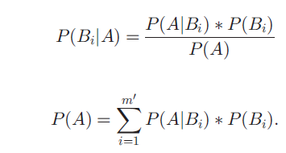

Continued…
The prior probability of each physical host is calculated according to the remaining resource amount of the physical host and the resource amount users requested.
The posterior probability of each physical host is calculated on the basis of Bayes theorem.
Event of deploying some task into some physical host is event A
Event of choosing some physical host is event B
P(Bi/A) = Probability of happening of event B provided event A occurred

Slide 18
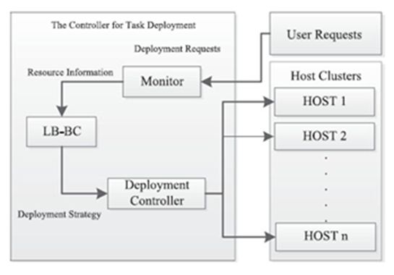
Architecture of the proposed LB-BC
Monitor acquires the information of resource requested by users’ tasks and the status information of remaining resource amount.
LB-BC generates the deployment strategy, which is transmitted to Deployment Controller.
The task requests accumulated within a time are deployed to the corresponding physical hosts in the final optimal set of physical hosts.
Figure 4: The view of LB-BC’s architecture [5]

Slide 19
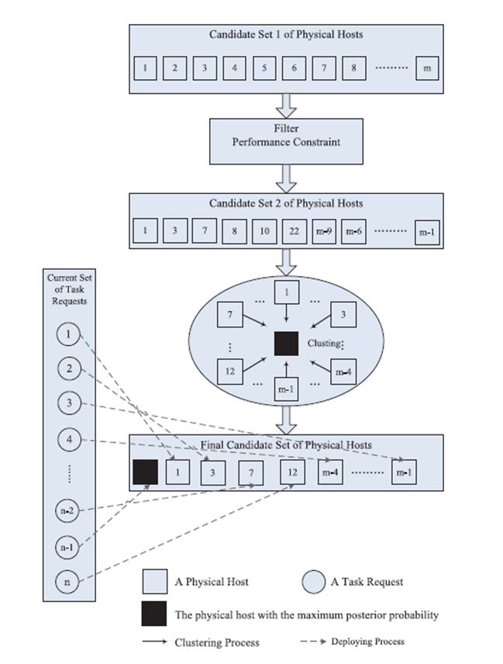
Process of LB-BC task deployment
Figure 5: The process of LB-BC task deployment [5]

Slide 20

Algorithm of LB-BC
Step 1(Filtering):
There are m(Large no.) physical hosts in the cloud data center, and each physical host needs to be assigned to a constraint value for measuring its remaining available computing power using:
L(i) = Remaining total resource of ith physical host
Lc(i) = Remaining CPU resource of ith physical host
Lmem(i) = Remaining memory resource of ith physical host
a(alpha) = weight value of CPU
b(Beta) = weight value of memory
Notes:
IaaS cloud data centers, there are too large numbers of physical hosts.

Slide 21


Continued…
The performance constraint value can be defined as the maximum requested resource amount in the set TR:
Define an empty set NPH={}, and the performance constraint value of the set of task requests is defined as the maximum requested resource amount in NPH.
R(i) = Remaining total resource of ith task
Rc(i) = Remaining CPU resource of ith task
Rmem(i) = Remaining memory resource of ith task
a(alpha) = weight value of CPU
b(Beta) = weight value of memory
Lmreq = maximum requested resource amount
Notes:
m’: New no. of physical hosts
m: Original no. of physical hosts

Slide 22

Step 2 (Probability calculation):
These physical hosts with better performance in the cloud data center are put into the set NPH.
However, can we ensure that each physical host from the set NPH can process any of the received task requests in TR?
Utilized the methods of probability theory and clustering to overcome the above hinderance.
Final prior probability of each physical host in the set NPH:
Lmreq = maximum requested resource amount
Li = Remaining total resource of ith physical host
Notes:
Quiz: Since some physical hosts may have large amount of available memory resource while little CPU resource, or vice versa. Their Li values are also very large, but they aren’t what we want.

Slide 23

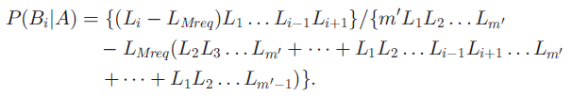
Continued…
There are m’ physical hosts in the set NPH, and the probability of choosing a physical host (Bi) is
Posterior probability of physical host i:

Slide 24

Step 3 (Clustering):
The posterior probability values of the physical hosts in the set NPH are sorted descending.
Let nphj represent the physical host with the biggest posterior probability in NPH and thus nphj is selected as the clustering center.
Similarity degree value between any other host i from NPH and nphj is as follows:
Lci = = Remaining CPU resource of ith physical host
Lcj = Remaining CPU resource of jth physical host
Pi = posterior probability values of the ith physical host
Pj = posterior probability values of the jth physical host
Lmi = Remaining memory resource of jth physical host
Lmj = Remaining memory resource of jth physical host

Slide 25
Step 4 (Final Candidate Set):
The threshold value T is given according to similarity degree values.
If the similarity degree value SD > threshold value T, then this object will become a member of the new set NPH’={}.
The clustering center nphj is the first member which is put into the set NPH’.
The final candidate set is the final clustering result NPH’:
NPH’ = (nph1,nph2,…nphq} where q<=m’<=m nph(x)= numbering of physical hosts
These requested tasks will be deployed into the physical hosts in the set NPH’.

Slide 26

Performance Evaluation
DLB deployment approach, the random deployment (RD) approach, and the proposed LB-BC deployment approach are compared as following aspects:
Comparison on MakeSpan
Load Balancing Effect
Notes:
Used CloudSim simulator which allows simulation scenarios by supporting dynamic creation of different kinds of entities and can add and remove data center entities at run-time.

Slide 27
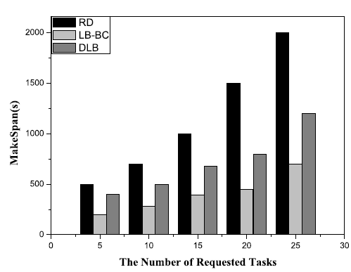
MakeSpan
It is the needed time of processing tasks set.
The RD approach has deployed the requested tasks at random.
DLB deployment approach just predicts requested tasks’ resource amount on the basis of its knowledge repository in the beginning.
LB-BC approach will select the optimal physical hosts set to deal with tasks in each round of iterations. It avoids a large amount of communication cost.
Figure 6: Comparison of RD, DLB, and LB-BC on MakeSpan [5]

Slide 28
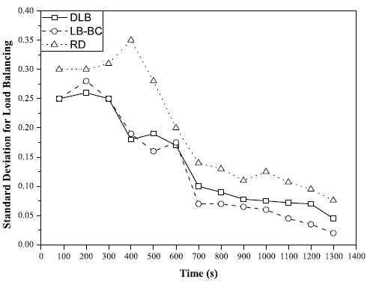
Load Balancing Effect
A smaller standard deviation value represents that the cloud data center has the better balancing of load.
LB-BC approach could find the optimal physical host quickly according to the remaining computing power.
DLB approach makes a prediction of each processor’s load first and deploys tasks in the light of knowledge repository.
Figure 7: Comparison of RD, DLB and LB-BC in load balancing.

Slide 29
Summary – LB-BC
The first step was to use performance values of the nodes and use it in comparison to narrow down the search.
In the next step, LBBC obtains the posteriori probability values of all candidate physical hosts using the Bayes theorem.
Finally, LB-BC has combined probability theorem and the clustering idea to pick out the optimal hosts set.
Deploying and executing tasks by selecting the physical host with the maximum posteriori probability value as the clustering center
Achieve the load balancing effect from the long-term perspective.

Slide 30
Load Balancing in Virtual Cluster using Fuzzy Clustering (LB-VC-FC)
[2] Huang, Weihua, et al. "Load balancing algorithm for virtual cluster using fuzzy clustering.“ Computer and Communications (ICCC), 2016 2nd IEEE International Conference on. IEEE, 2016.

Slide 31
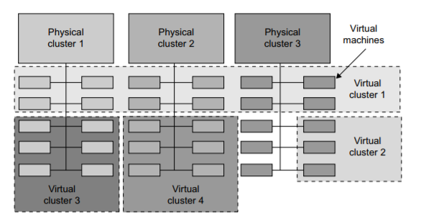
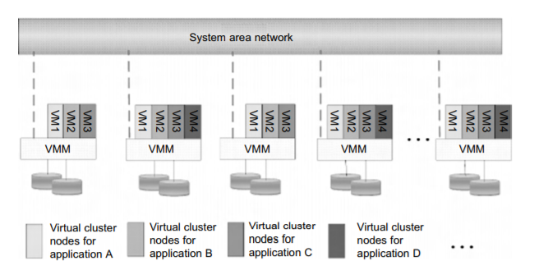
LB-VC-FC Virtual Clusters
Virtual Cluster – built with VMs installed at distributed servers from one or more physical clusters. [10]
Interconnected by an overlay virtual network across physical networks
Has dynamic boundaries
Figure 8: A cloud platform with 4 virtual cluster over 3 physical clusters [10]
Figure 9: Virtual clusters based on application partitioning [10]
[10]Hwang, Kai, Jack Dongarra, and Geoffrey C. Fox. Distributed and cloud computing: from parallel processing to the internet of things. Morgan Kaufmann, 2013.
Notes:
Definitions:
Virtual Clusters -Virtual clusters are built with VMs installed at distributed servers from one or more physical clusters. The VMs in a virtual cluster are interconnected logically by a virtual network across several physical networks
The boundary of a virtual cluster can change as VM nodes are added, removed, or migrated dynamically over time.
A physical cluster is a collection of servers (physical machines) interconnected by a physical network such as a LAN

Slide 32
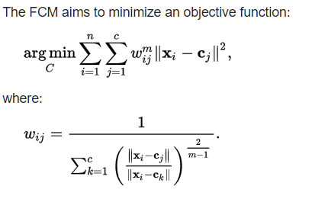
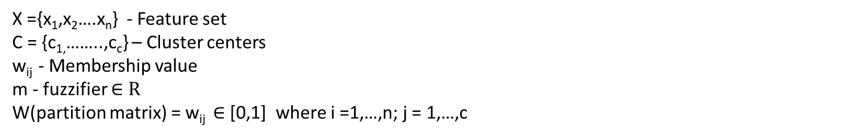
LB-VC-FC Fuzzy Clustering
Fuzzy Clustering – allows one feature to be part of multiple clusters
Feature sets have Degree of membership
F C-means clustering – most widely used fuzzy clustering algorithm
X ={x₁,x₂….x_{n}} - Feature set
C = {c_{1,}……..,c_{c}} – Cluster centers
w_{ij} - Membership value
m - fuzzifier $∈R$
W(partition matrix) = w_{ij} $∈$ [0,1] where i =1,…,n; j = 1,…,c

Slide 33
LB-VC-FC
Existing fuzzy clustering based algorithms consider multi-class system resources but balance the load in a combined way
The node loads are dynamically changing and cause difficulty in partitioning
The newly proposed solution optimizes the objective function in fuzzy clustering to consider variable workloads of CPU utilization, network and memory
Each load of system resources is treated as one dimension of the comprehensive loads
Feature weight is attached to each dimension.[2]

Slide 34
LB-VC-FC
Model Formulation
1. Forming objective function for fuzzy clustering
Distance metric based on Bregman Divergence (distortion measurement)
Penalty term added that violates feature weight preference – to avoid overfitting
Weight balancing term in terms of entropy – smoothens out the weight distribution
2. Objective function Optimization
The objective function obtained in step 1 is turned into a convex quadratic optimization problem by fixing 2 of 3 unknown variables
3. Selection and location strategy
Virtual machine to be migrated is selected based on max(R) where R_{i} = C_{i}/M_{i}
C_{i} - CPU utilization rate
M_{i} - Memory utilization rate

Slide 35
LB-VC-FC Algorithm
Step 1 : Initialization – initialize the cluster number, cluster center and feature weight preferences;
Step 2 : Sample the utilization rate of CPU, memory and network in the nodes to obtain load data set; calculate the comprehensive loads for all the nodes and then calculate their standard deviation;
Step 3 : Iterative through the load data sets by taking sets of two known variables to compute clustering results of node loads, cluster centres and membership matrix and feature weight preference for nodes in every dimension until convergence is met at the optimal solution;(Optimal objective function used)
Step 4 : After clustering, the optimal partitions can be obtained. The virtual machine can be transferred according to the selection and location strategy to realize load balancing. Then re-calculate the standard deviation for the node loads in the virtual cluster: if it is lower than the threshold, the load balancing processing is completed; otherwise, repeat step 3.
[2] Huang, Weihua, et al. "Load balancing algorithm for virtual cluster using fuzzy clustering.“ Computer and Communications (ICCC), 2016 2nd IEEE International Conference on. IEEE, 2016.

Slide 36
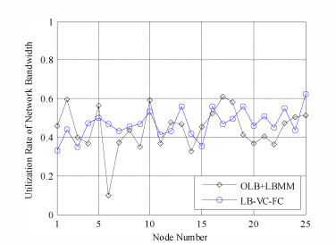
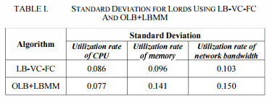
LB-VC-FC – network load comparison with OLB_LBMM
Improved network bandwidth utilization rate
[2] Huang, Weihua, et al. "Load balancing algorithm for virtual cluster using fuzzy clustering.“ Computer and Communications (ICCC), 2016 2nd IEEE International Conference on. IEEE, 2016.

Slide 37
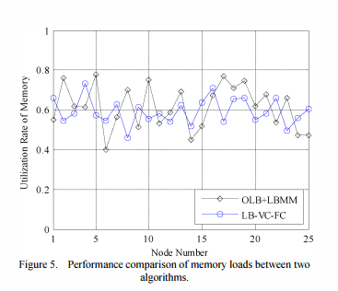
LB-VC-FC – Memory load comparison with OLB_LBMM
Improved memory utilization rate
[2] Huang, Weihua, et al. "Load balancing algorithm for virtual cluster using fuzzy clustering.“ Computer and Communications (ICCC), 2016 2nd IEEE International Conference on. IEEE, 2016.

Slide 38
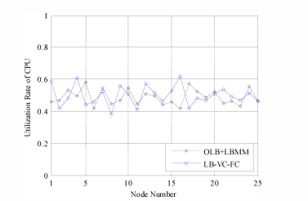
LB-VC-FC – CPU load comparison with OLB_LBMM
Sub-optimal CPU utilization rate
[2] Huang, Weihua, et al. "Load balancing algorithm for virtual cluster using fuzzy clustering.“ Computer and Communications (ICCC), 2016 2nd IEEE International Conference on. IEEE, 2016.

Slide 39
Summary LB-VC-FC
Main concept
Consider dynamic variable loads of multi-class system resources by treating each resource as a separate dimension and optimizing the objective function in F C-means Clustering
Advantages
Optimizes memory and network utilization rate
Considers dynamic load
Disadvantages
Results in sub-optimal CPU utilization rate

Slide 40
Conclusion
We have seen the following LB algorithms in cloud computing
1. OLB
2. LBMM
3. Join-Idle-Queue
4. Honey-bee foraging
5. LB-BC
6. LB-VC-FC
And familiarized ourselves with the methods and challenges in dynamic load balancing of variable workloads; still a lot of work is being done in order to improve on these load balancing strategies to achieve high efficiency, throughput and scalability of systems.

Slide 41
Future Work
we propose to extend our research on LB-VC-FC and optimize the CPU utilization rate of the algorithm by using Naïve Bayes Theorem and dynamic programming in the VM selection strategy.

Slide 42
References
[1] Bhavya, V. V., K. P. Rejina, and A. S. Mahesh. "An Intensification of Honey Bee Foraging Load Balancing Algorithm in Cloud Computing.“
[2] Huang, Weihua, et al. "Load balancing algorithm for virtual cluster using fuzzy clustering.“ Computer and Communications (ICCC), 2016 2nd IEEE International Conference on. IEEE, 2016.
[3] Kansal, Nidhi Jain, and Inderveer Chana. "Cloud load balancing techniques: A step towards green computing." IJCSI International Journal of Computer Science Issues 9.1 (2012): 238-246.
[4] Lu, Yi, et al. "Join-Idle-Queue: A novel load balancing algorithm for dynamically scalable web services." Performance Evaluation 68.11 (2011): 1056-1071.
[5] Zhao, Jia, et al. "A heuristic clustering-based task deployment approach for load balancing using bayes theorem in cloud environment." IEEE Transactions on Parallel and Distributed Systems 27.2 (2016): 305-316.
[6] Shah, Nadeem, and Mohammed Farik. "Static Load Balancing Algorithms In Cloud Computing: Challenges & Solutions." International Journal Of Scientific & Technology Research 4.10 (2015).

Slide 43
References
[7] Kumar, Sushil, and D. H. Rana. "Various Dynamic Load Balancing Algorithms in Cloud Environment: A Survey." International Journal of Computer Applications 129.6 (2015): 14-19.
[8] Kokilavani, T., and DI George Amalarethinam. "Load balanced min-min algorithm for static meta-task scheduling in grid computing." International Journal of Computer Applications 20.2 (2011): 43-49.
[9] M. Randles, D. Lamb, and A. Taleb-Bendiab, “A Comparative Study into Distributed Load Balancing Algorithms for Cloud Computing”, Proceedings of 24th IEEE International Conference on Advanced Information Networking and Applications Workshops, Perth, Australia, April 2010, pages 551-556
[10]Hwang, Kai, Jack Dongarra, and Geoffrey C. Fox. Distributed and cloud computing: from parallel processing to the internet of things. Morgan Kaufmann, 2013.

Slide 44
Thank you

